Slide 1


THE MOVIE DATABASE
Title: Web Scrapping and Exploratory Data Analysis of The Movie Data

Slide 2
About Us
We are Akshith Chidurala , Pavan Adithya B.Tech, Computer Science Engineering students from GITAM University, passionate about data analytics and visualization.
Continuously learning to enhance expertise in data science and analytics tools.
GITHUB - https://github.com/VU21CSEN0100931
LINKEDIN https://www.linkedin.com/in/akshith-chidurala-752a09272/-
GITHUB- https://github.com/adithya0510
LINKEDIN- http://www.linkedin.com/in/pavan-adithya-43762627a

Slide 3
Preface:
ØINTRODUCTION
ØBUSINESS PROBLEM
ØOBJECTIVE
ØTOOLS USED
ØWEB SCRAPPING
ØDATA CLEANING STEPS
ØDATA VISUALIZATION
KEY-BUSINESS QUESTIONS
ØCONCLUSION
EXPERIENCE & CHALLANGES

Slide 4
Introduction:
The film industry generates massive amounts of data every year — from production budgets to audience ratings and box office collections.
Platforms like The Movie Database (TMDB) provide valuable public datasets that reflect audience preferences, global movie trends, and performance indicators.
This project focuses on exploring and analyzing TMDB movie data to understand how different features like ratings, popularity, release year, and language influence a movie’s success.
Through data analysis and visualization, the project aims to uncover patterns and insights that can be useful for movie studios, streaming services, and audiences alike.

Slide 5
Business Problem:
The movie industry faces a major challenge in understanding what drives audience engagement and movie success.
While thousands of movies are released every year, only a few achieve high ratings and widespread popularity.
By analyzing TMDB movie data, we can:
Identify factors that influence ratings and popularity.
Understand audience preferences across years and languages.
Help production houses and streaming platforms make data- driven decisions about content creation and marketing.

Slide 6
Objectives:
To perform Exploratory Data Analysis (EDA) on TMDB movie data.
To identify key factors affecting movie ratings, popularity, and audience engagement.
To visualize insights through meaningful charts and graphs for business interpretation.
To understand temporal trends in movie performance across different years and decades.
To derive data-driven insights that can assist production houses, OTT platforms, and analysts in making informed content and marketing decisions.

Slide 7
Web Scraping:
The movie data was collected using the TMDB API instead of traditional HTML scraping.
A unique API key was used to access and retrieve movie details programmatically.
Data was fetched in JSON format and converted into a structured Pandas DataFrame for analysis.
Collected the extracted data into a structured dataset (CSV format) for further data cleaning and analysis using Pandas.
Ensured data integrity and accuracy by validating the API responses and removing duplicate movie entries.

Slide 8
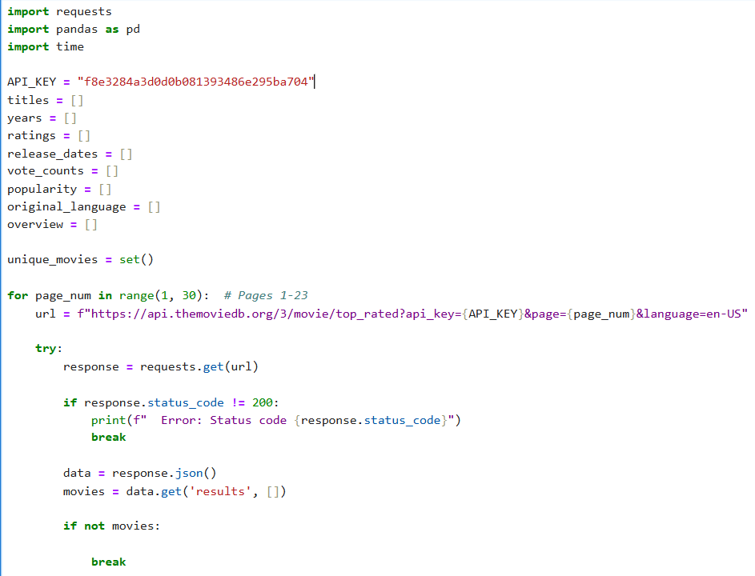
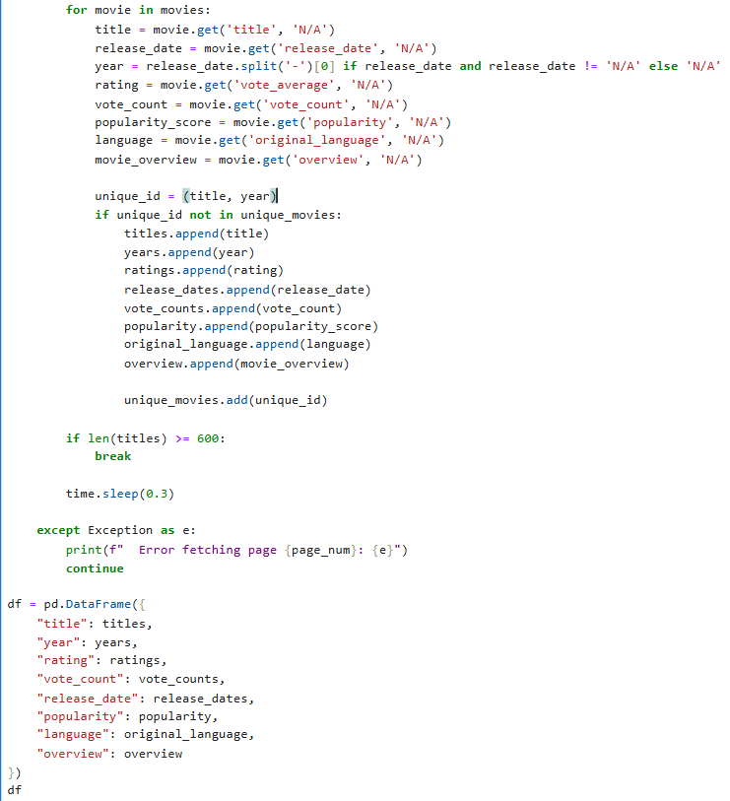

Slide 9
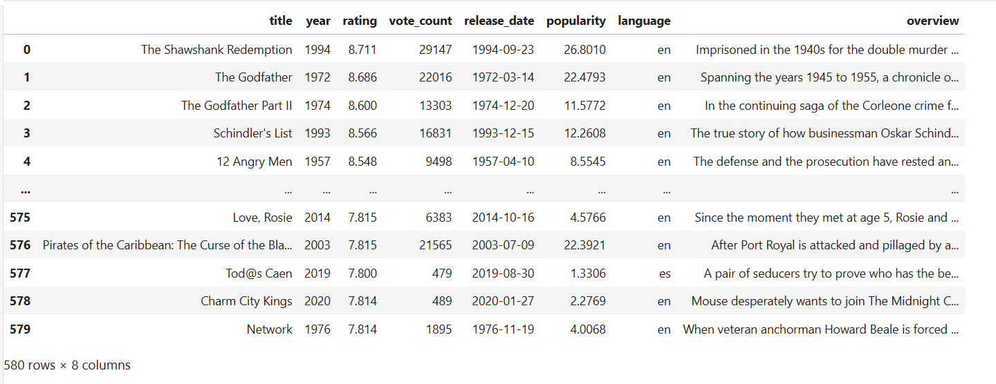
Dataset:

Slide 10
Exploratory Data Analysis
1) Data cleaning steps:
Removed duplicate and irrelevant rows.
Checked for missing values and handled them appropriately.
Converted data types (e.g.release_date → datetime, year → int).
Derived additional features like movie_age and decade.
Verified consistency across numerical and categorical attributes.

Slide 11
2) Data Manipulation Steps:
Grouped data by year, language, and popularity for trend analysis.
Created categorical bins for ratings and popularity.
Extracted insights using aggregated statistics such as mean rating per decade.
Prepared subsets of the data for visualizations.

Slide 12
3) Univariate Analysis:
In the univariate analysis, various single-variable visualizations were performed to understand the overall distribution and behavior of movie attributes.
I used histograms, count plots, and boxplots to analyze the distribution of continuous and categorical variables.
The rating distribution showed that most movies were rated between 6.0 and 8.0, indicating that TMDB ratings are generally favorable.
The vote count distribution revealed that a small number of blockbuster movies attracted the majority of votes, while many low-budget or regional films received fewer votes.
Analysis of release years showed a sharp rise in movie releases during the 2010–2020 decade, reflecting the rapid expansion of global cinema and streaming platforms.
The language distribution highlighted that English movies dominate the dataset, followed by French, Spanish, and Hindi films.
I also created countplots and bar charts to visualize the frequency of movies across different popularity and rating categories, making it easier to interpret patterns visually.

Slide 13
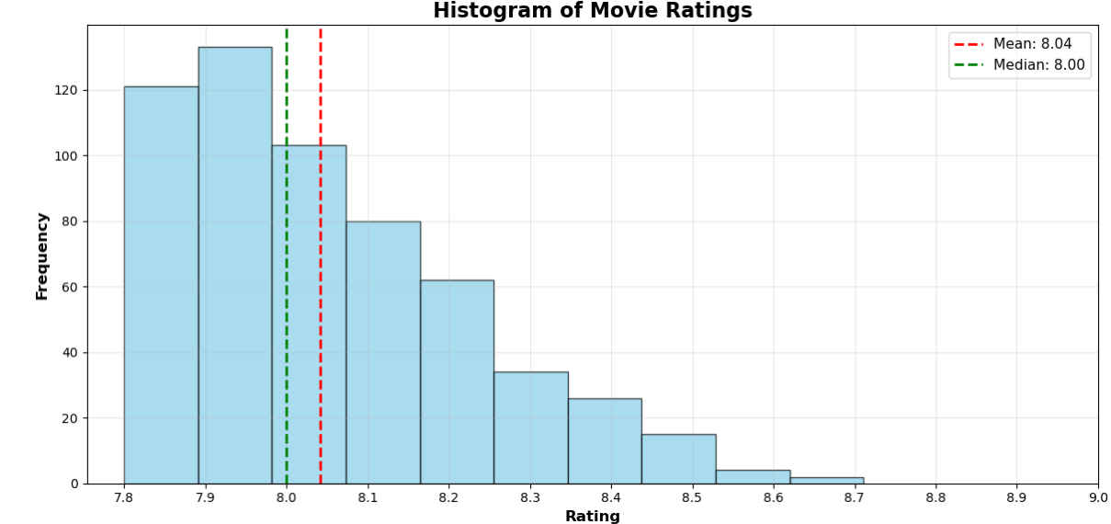
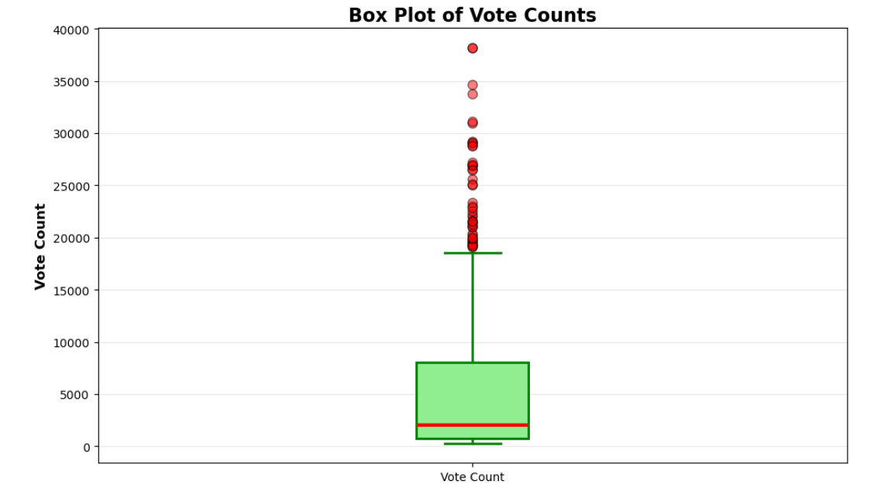
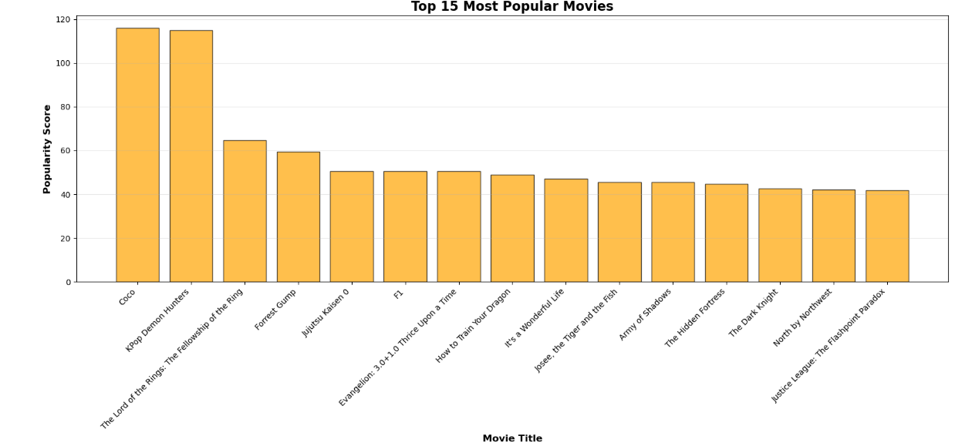
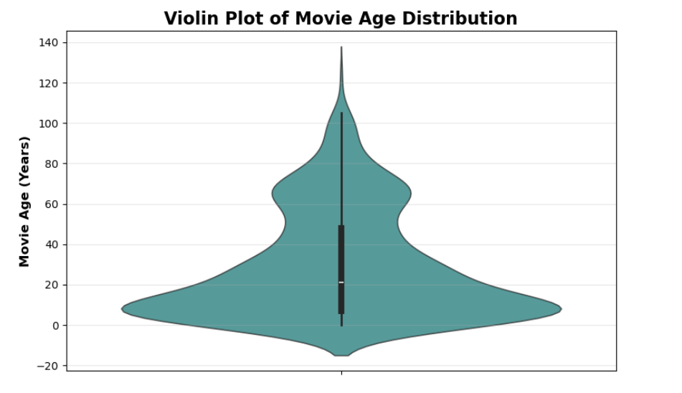
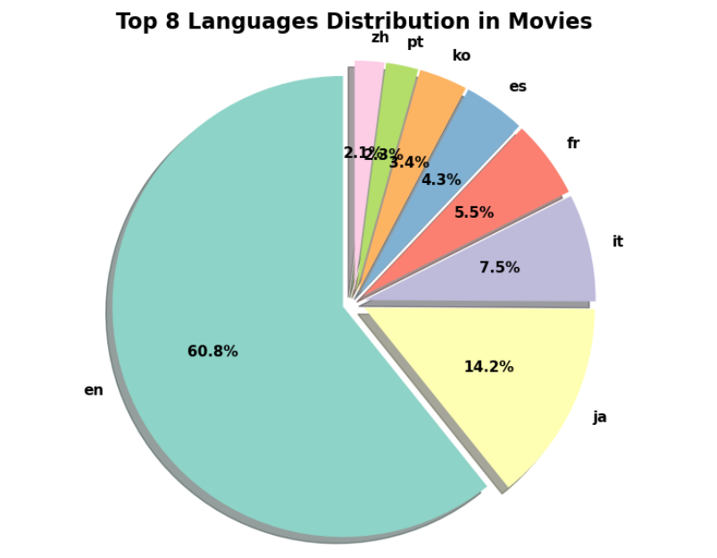
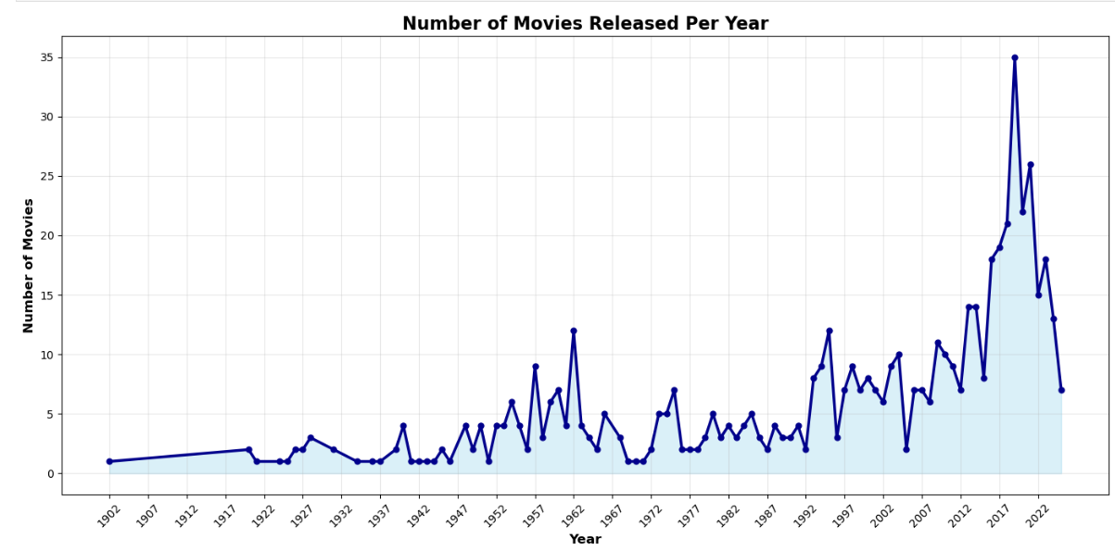

Slide 14
4) Bivariate Analysis:
In the bivariate analysis, I explored relationships between variables using three visualizations —
Bar Plot, Heatmap, and Stacked Bar Chart.
Bar Plot (Average Rating vs. Language):
Compared the average ratings across different languages.
English movies had the most consistent and higher ratings, followed by French and Spanish films.
Heatmap (Decade, Average Rating, and Language):
Showed how average ratings varied across decades and languages.
The 2010–2020 decade had the highest movie activity and slightly better ratings overall.
Stacked Bar Chart (Popularity Category, Rating, and Percentage):
Displayed how ratings are distributed across popularity categories.
Most movies fall into the medium popularity range with ratings between 6 and 8, while highly popular movies often have mixed ratings.

Slide 15
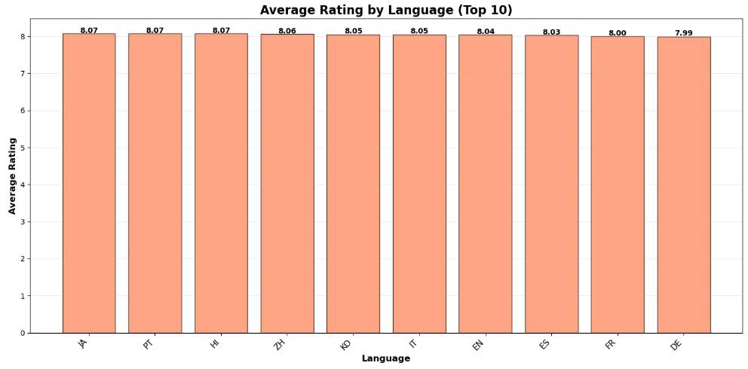
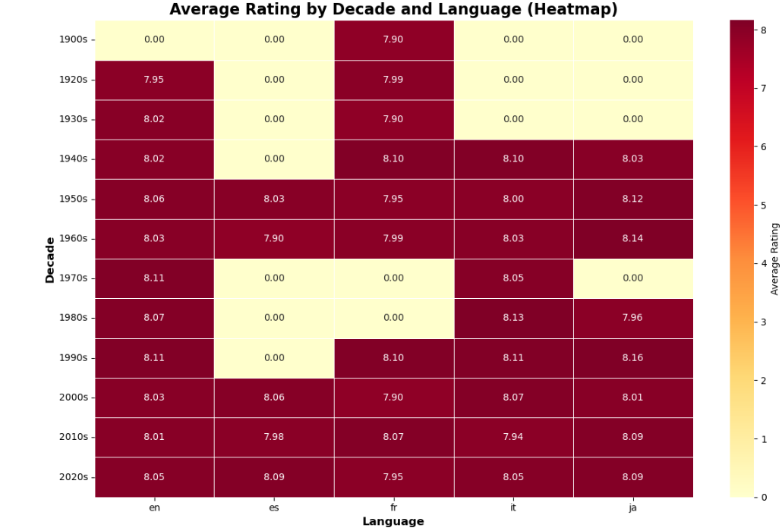
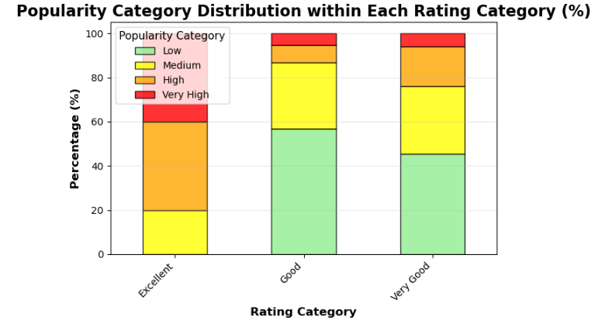

Slide 16
5) Multivariate Analysis:
For multivariate analysis, I examined the combined relationship among multiple variables using Pair Plot and Scatter Plot to understand overall movie trends.
Pair Plot (Rating, Vote Count, Popularity, Year):
The pair plot visualized how these four key features interact with one another.
It showed a positive relationship between vote count and popularity, indicating that movies receiving more votes tend to be more popular.
Ratings remained moderately distributed, showing that high popularity does not always mean higher ratings.
The year dimension helped identify how audience engagement evolved over time.
Scatter Plot (Year, Popularity, Rating):
The scatter plot illustrated how popularity and rating vary across release years.
It revealed that recent years (2010–2020) had more movies with higher popularity,
Some earlier movies still maintained strong ratings despite lower popularity, showing long-term audience appreciation.

Slide 17
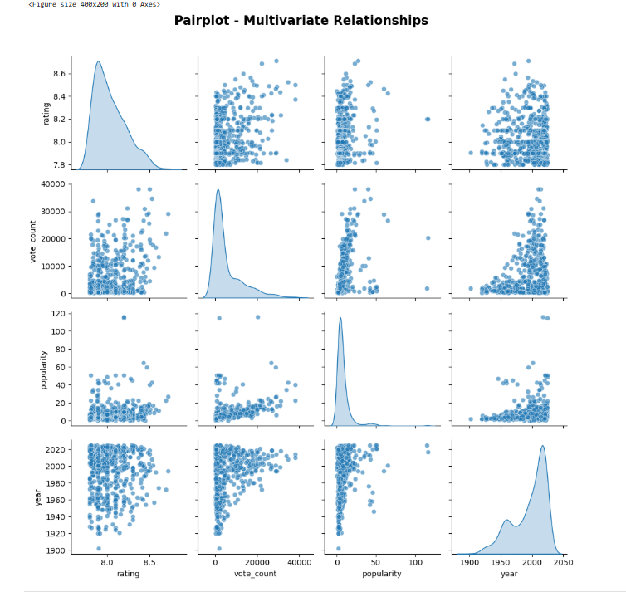
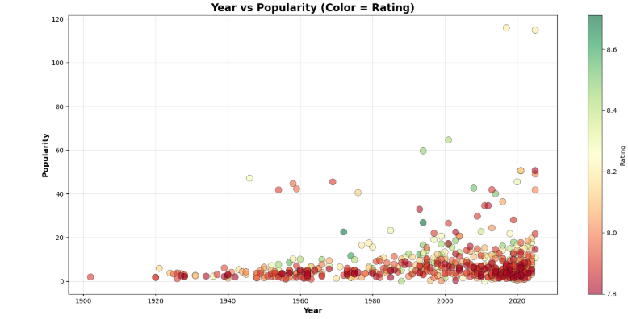

Slide 18
Key Business Questions Answered:
Which decade produced the highest-rated movies?
→ The 2010–2020 decade.
Do higher votes imply higher ratings?
→ Not always, but they often align with popularity.
Which languages dominate the movie market?
→ English, followed by French, Spanish, and Hindi.
What are the indicators of a successful movie?
→ Strong ratings, high vote counts, and strong audience popularity.

Slide 19
Conclusion:
The TMDB dataset reveals valuable insights into movie trends, audience preferences, and performance drivers.
English-language movies dominate both in volume and reach, with regional films showing selective success.
The 2010–2020 decade was the most active and impactful period for movie production.
Popularity and rating are not always directly related — visibility and engagement often depend on audience scale.
Features like vote count, language, and decade play key roles in understanding audience behavior.
This analysis demonstrates how data-driven insights can help producers and OTT platforms plan better content strategies.

Slide 20
Experience & Challenges:
Handling missing and inconsistent data required detailed preprocessing.
Implementing API pagination and avoiding duplicates was challenging.
Understanding correlations and visual interpretation took time to refine.
Overall, this project improved my skills in data analysis, visualization, and storytelling.

Slide 21

THANK YOU

